Slide 1

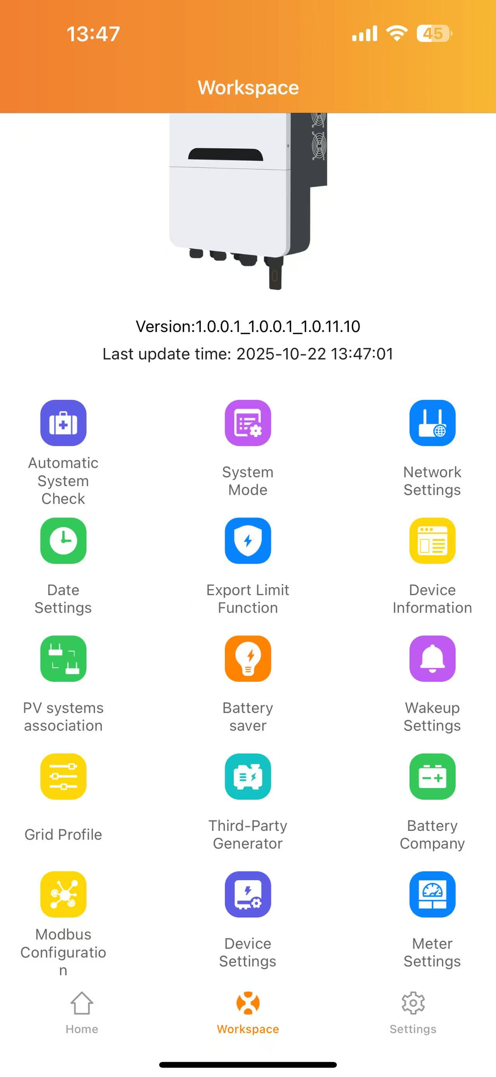
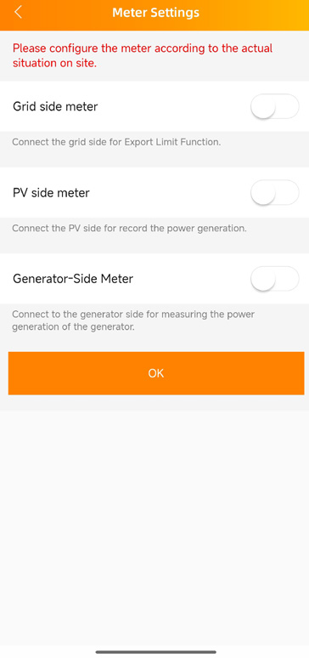
10.ELT-12 connected to CHNT Meter（NEW)
Current status: EMA Manager are available.
Functional description：
1. Replacing the original CT sampling with the CHNT Meter can simplify the CT wiring.
2. The CHNT Meter can be connected to different-sized CTs. When the electricity consumption of the client exceeds the upper limit of the standard CT included in the PCS, a solution can be adopted where the CHNT Meter is connected to a larger CT.
EMA Manager operations：
1. During the initialization process of EMA Manager, select the electricity meter function for configuration.
2. Log in to the system locally on EMA Manager and go to "Workspace" - "Meter Settings" to set the electricity meters.
3. Log in remotely to the customer system on EMA Manager and enter "Workspace" - "Remote control" - "Meter Settings" to set the electricity meters.

Slide 2
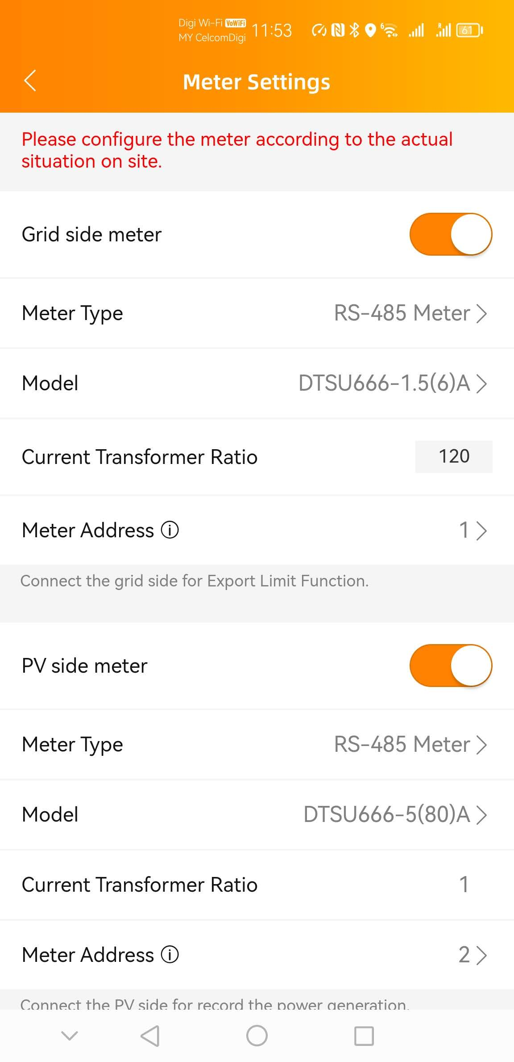
10.ELT-12 connected to CHNT Meter（NEW)
Note：
1. The installation location of the CHNT Meter remains the same as that of the original CT, and it cannot be changed.
2. The CHNT Meter has many models. When choosing the meter model, be sure to compare with the actual model. APS cannot perform 3. When setting the meter address, Meter Address 1 is for the Grid side, and Meter Address 2 is for the PV Production side.

Slide 3
11.ELT-12 connceted to Shelly Meter（NEW)
Current status: EMA Manager are available.
Functional description：
1. Replace the original CT sampling with the Shelly meter. The CT wiring is completely omitted.
2. The sampling data from the Shell meter is sent back to the ELT-12 via the cloud, enabling the remote export limit function.
EMA Manager＆EMA Web operations：
1. During the initialization process of EMA Manager, select the electricity meter function for configuration.
2. Log in to the system locally on EMA Manager and go to "Workspace" - "Meter Settings" to set the electricity meter.
3. Log in remotely to the customer system on EMA Manager and go to "Workspace" - "Remote control" - "Meter Settings" to set the electricity meter.

Slide 4
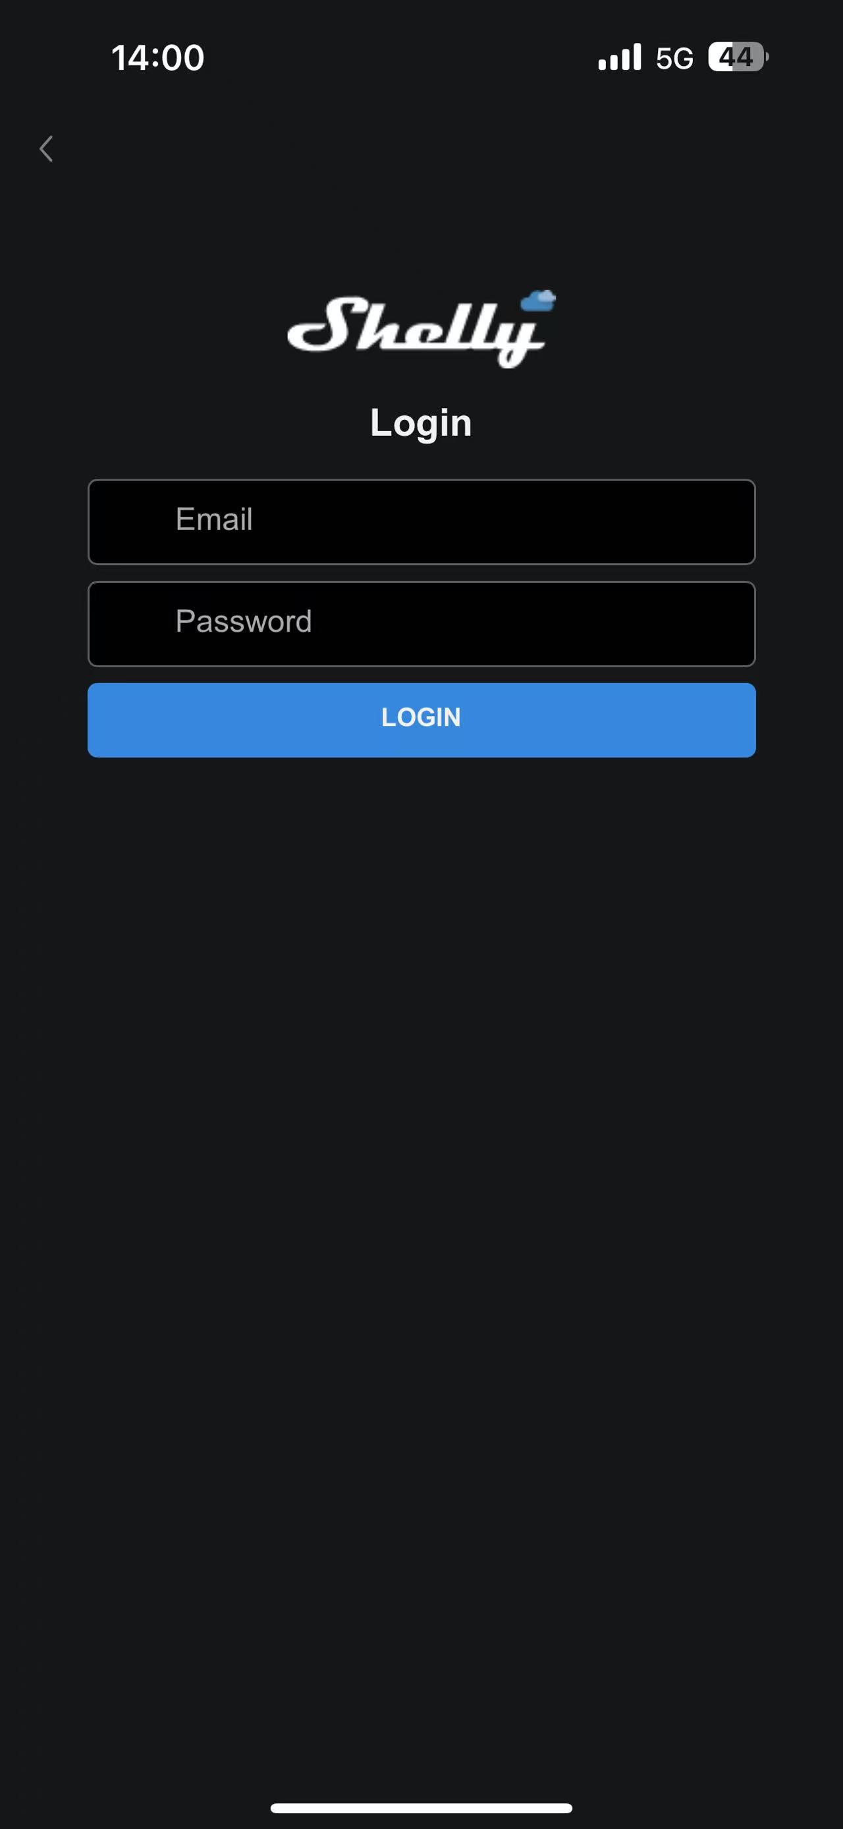
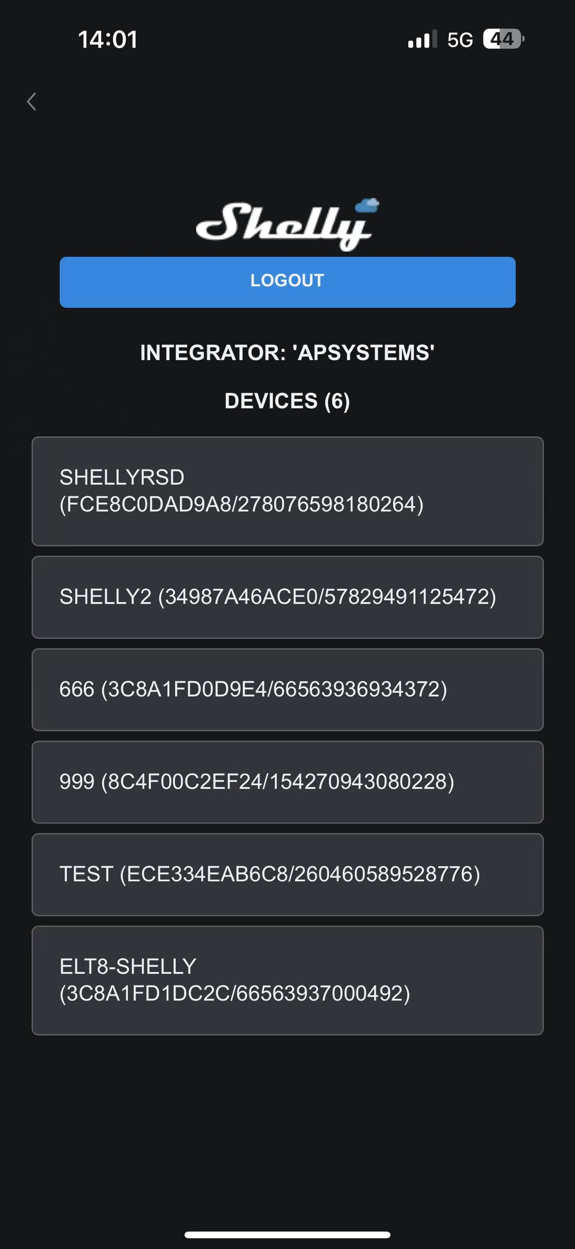
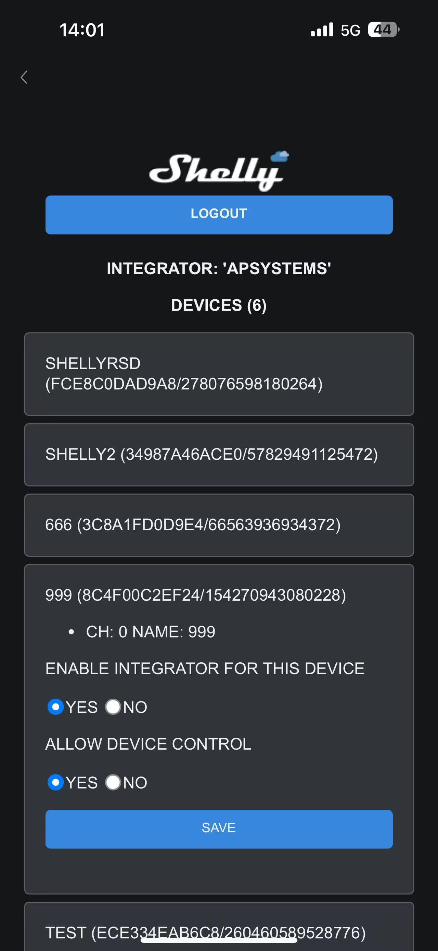
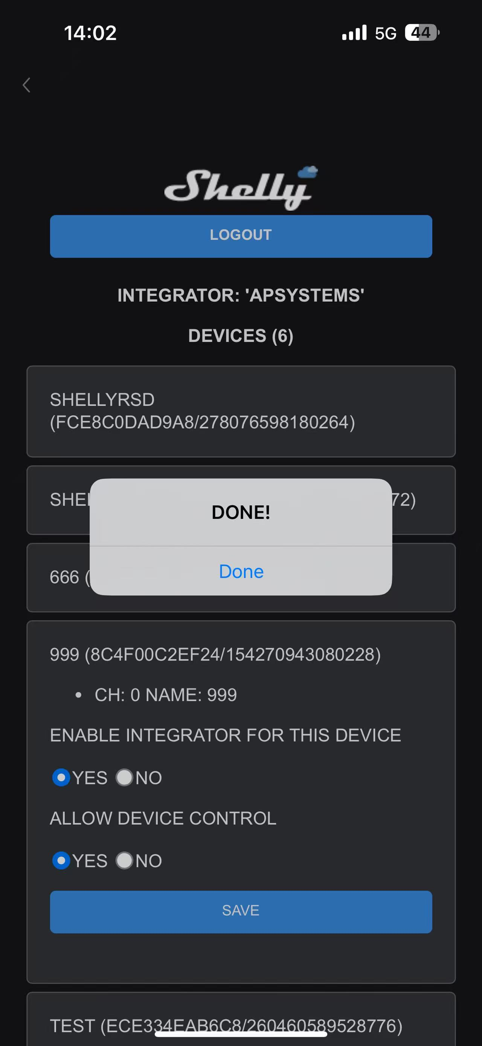
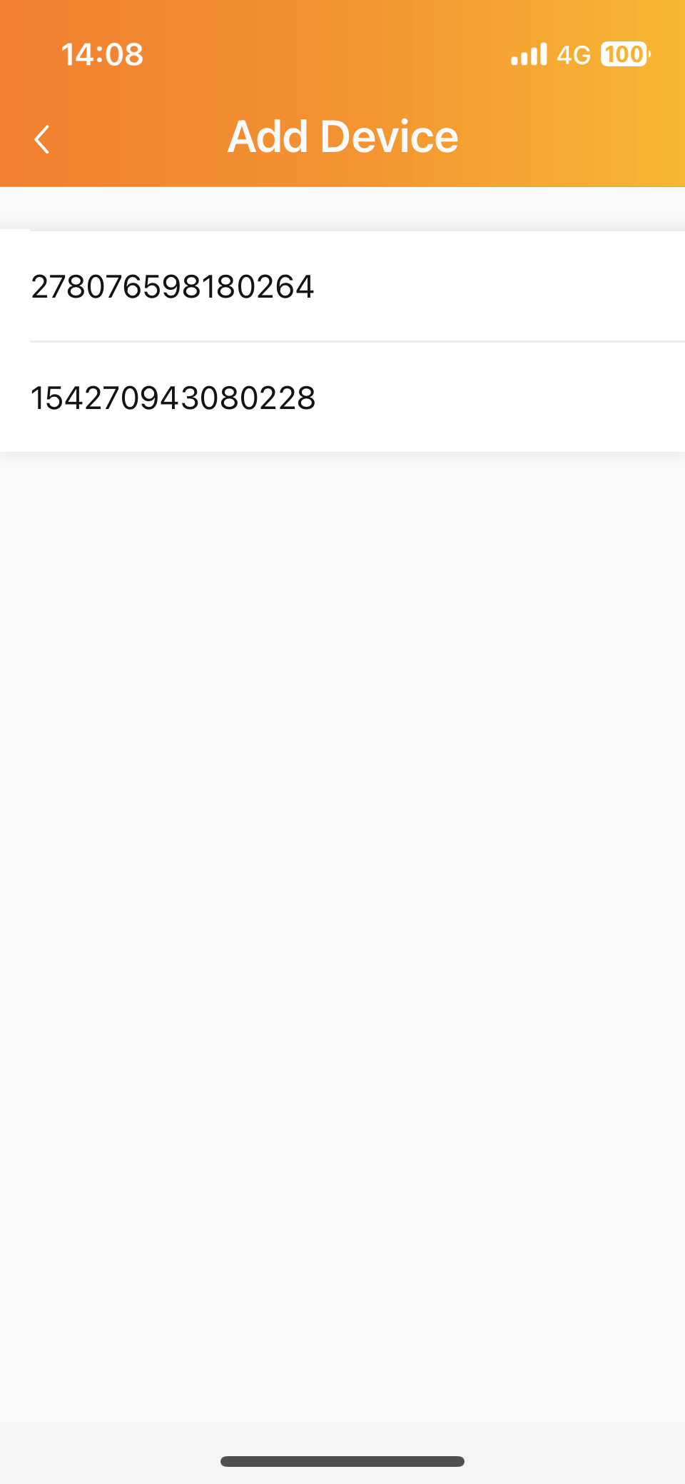
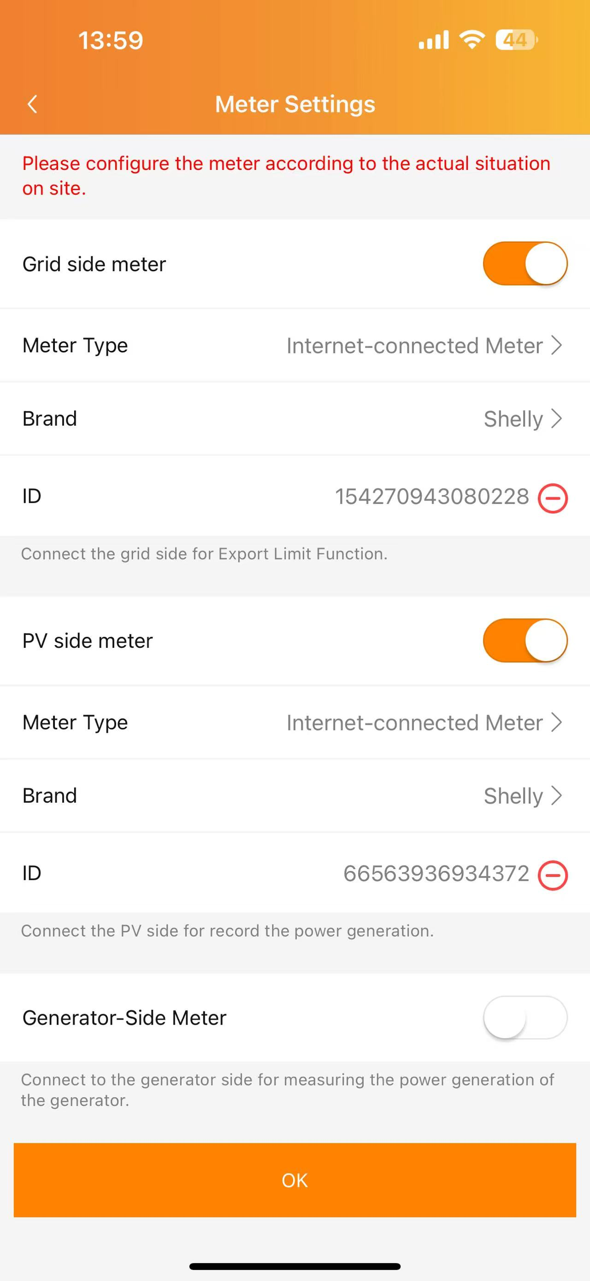
11.ELT-12 connceted to Shelly Meter（NEW)
Note：
1. Compared with the CHNT meter and CT sampling, the sampling of the Shelly meter will have a slight delay.
2. The power data sampled by the Shelly meter is real-time. However, the battery level data is reported every 5 minutes, so there will be a certain deviation between the battery level data and the power data when displayed. All should be based on the power data.

Slide 5
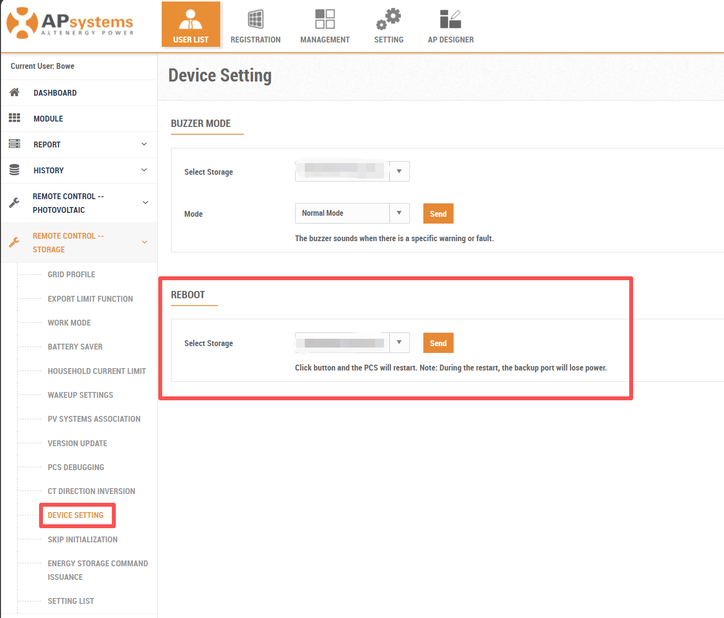
12.Remote software Reboot Function（NEW)
Current status: EMA Manager＆EMA Web are available.
Functional description：
1. When there is a problem with the client's system and it cannot be resolved. It is possible to remotely perform the software restart.
EMA Web operations：
1. On EMA Web, in "Remote Control Storage" - "Device Settings"-“Reboot” to make the settings.
2. Log in to the system locally on EMA Manager and go to "Workspace" - "Device Settings"-“Reboot” to make the settings.
3. Log in remotely to the customer system on EMA Manager and go to "Workspace" - "Remote control" - "Device Settings"-“Reboot” to make the settings.
Note：
1. This function only supports remote software-based restart. Remote hardware restart is currently not supported.

